Slide 1
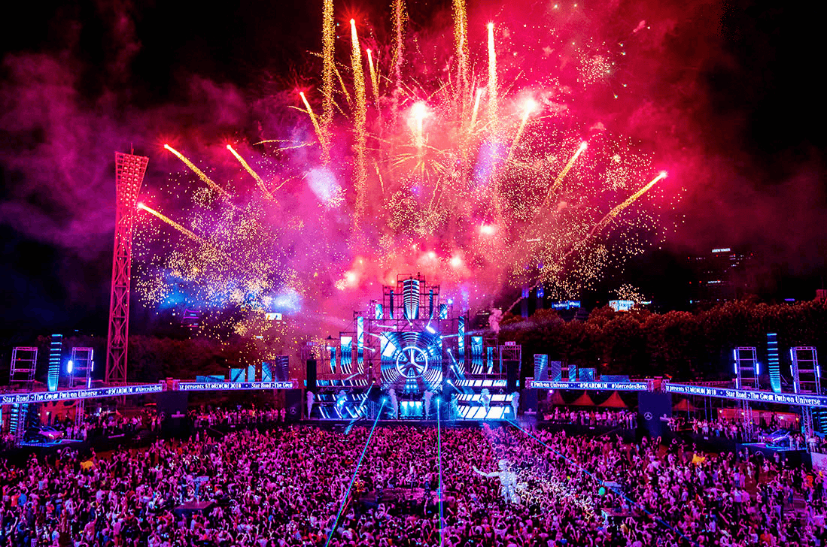

Team 3 Project Presentation
1. Motivation
2. The overall concept of your application
3. Demo of product
4. Tech used
5.Form Follows Function
6.Directions for future development

Slide 2
Team Partake
Jenine Ellis
John Dahle
Madeleine Kemeny
Daniel Fripp
Charles Monuma
Ian Lukidis

Slide 3
Motivation
The overall motivation to enable people to enjoy Lollapalooza to the fullest .
With over hundreds bands playing at the event being able to sample all the music offering it important to enhance the visitor experience.

Slide 4
Concept Of The Application
Enable users to explore music from a push of a button
Allows users to learn more about the artist before attend the concert
Give users a different perspective of Lollapalooza

Slide 5
Tech used
Bootstrap and CSS -
Ajax and API – Ticket master and Spotify
JavaScript and jQuery
We used tables to dynamically populate information taking from API’s

Slide 6
Demo of product
Now will show you a demo and functionary of the project

Slide 7
Form Follows Function
Performer lineup list: Ticket-Master API
List of artists are sortable
Performer names are clickable
Performer Details / Spotify API
requires credential/token
Username and password
populate three tabs:
1. “Artist”: image/artist name/link to artist page on Spotify
2. “Playlist”: list of available content through Spotify
3. ”Top Tracks”: songs as rated through Spotify.

Slide 8
Directions for future development
In 1991 when Lollapalooza launch the first concert it was simply about rock band which was operated like a circus traveling from city to city
Now Lollapalooza have a home in Chicago we have many to offer an ambience like that bring thousand of people to the city. Our application allow them to plan ahead, and enjoy all Chicago has to offer.

